Slide 1
How to use these Lessons
By sanjay and Arvind Seshan

Slide 2
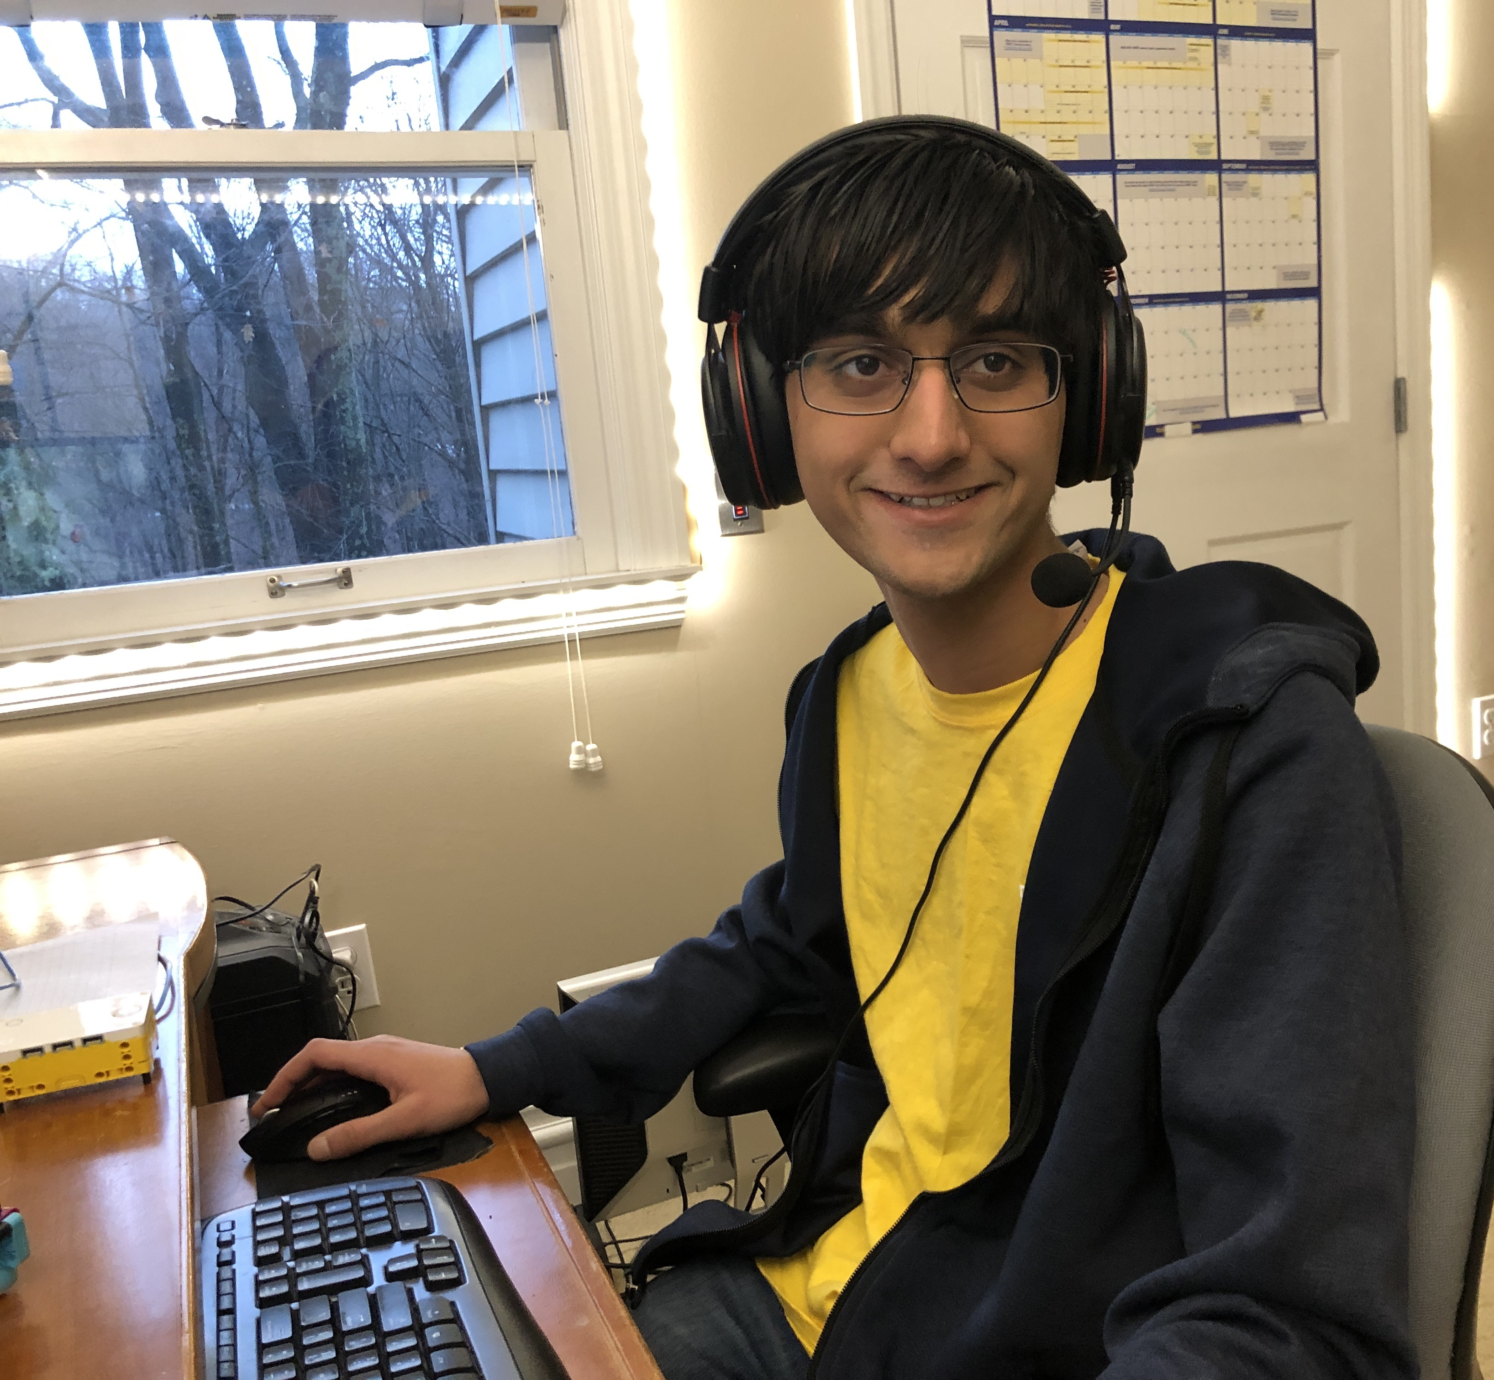
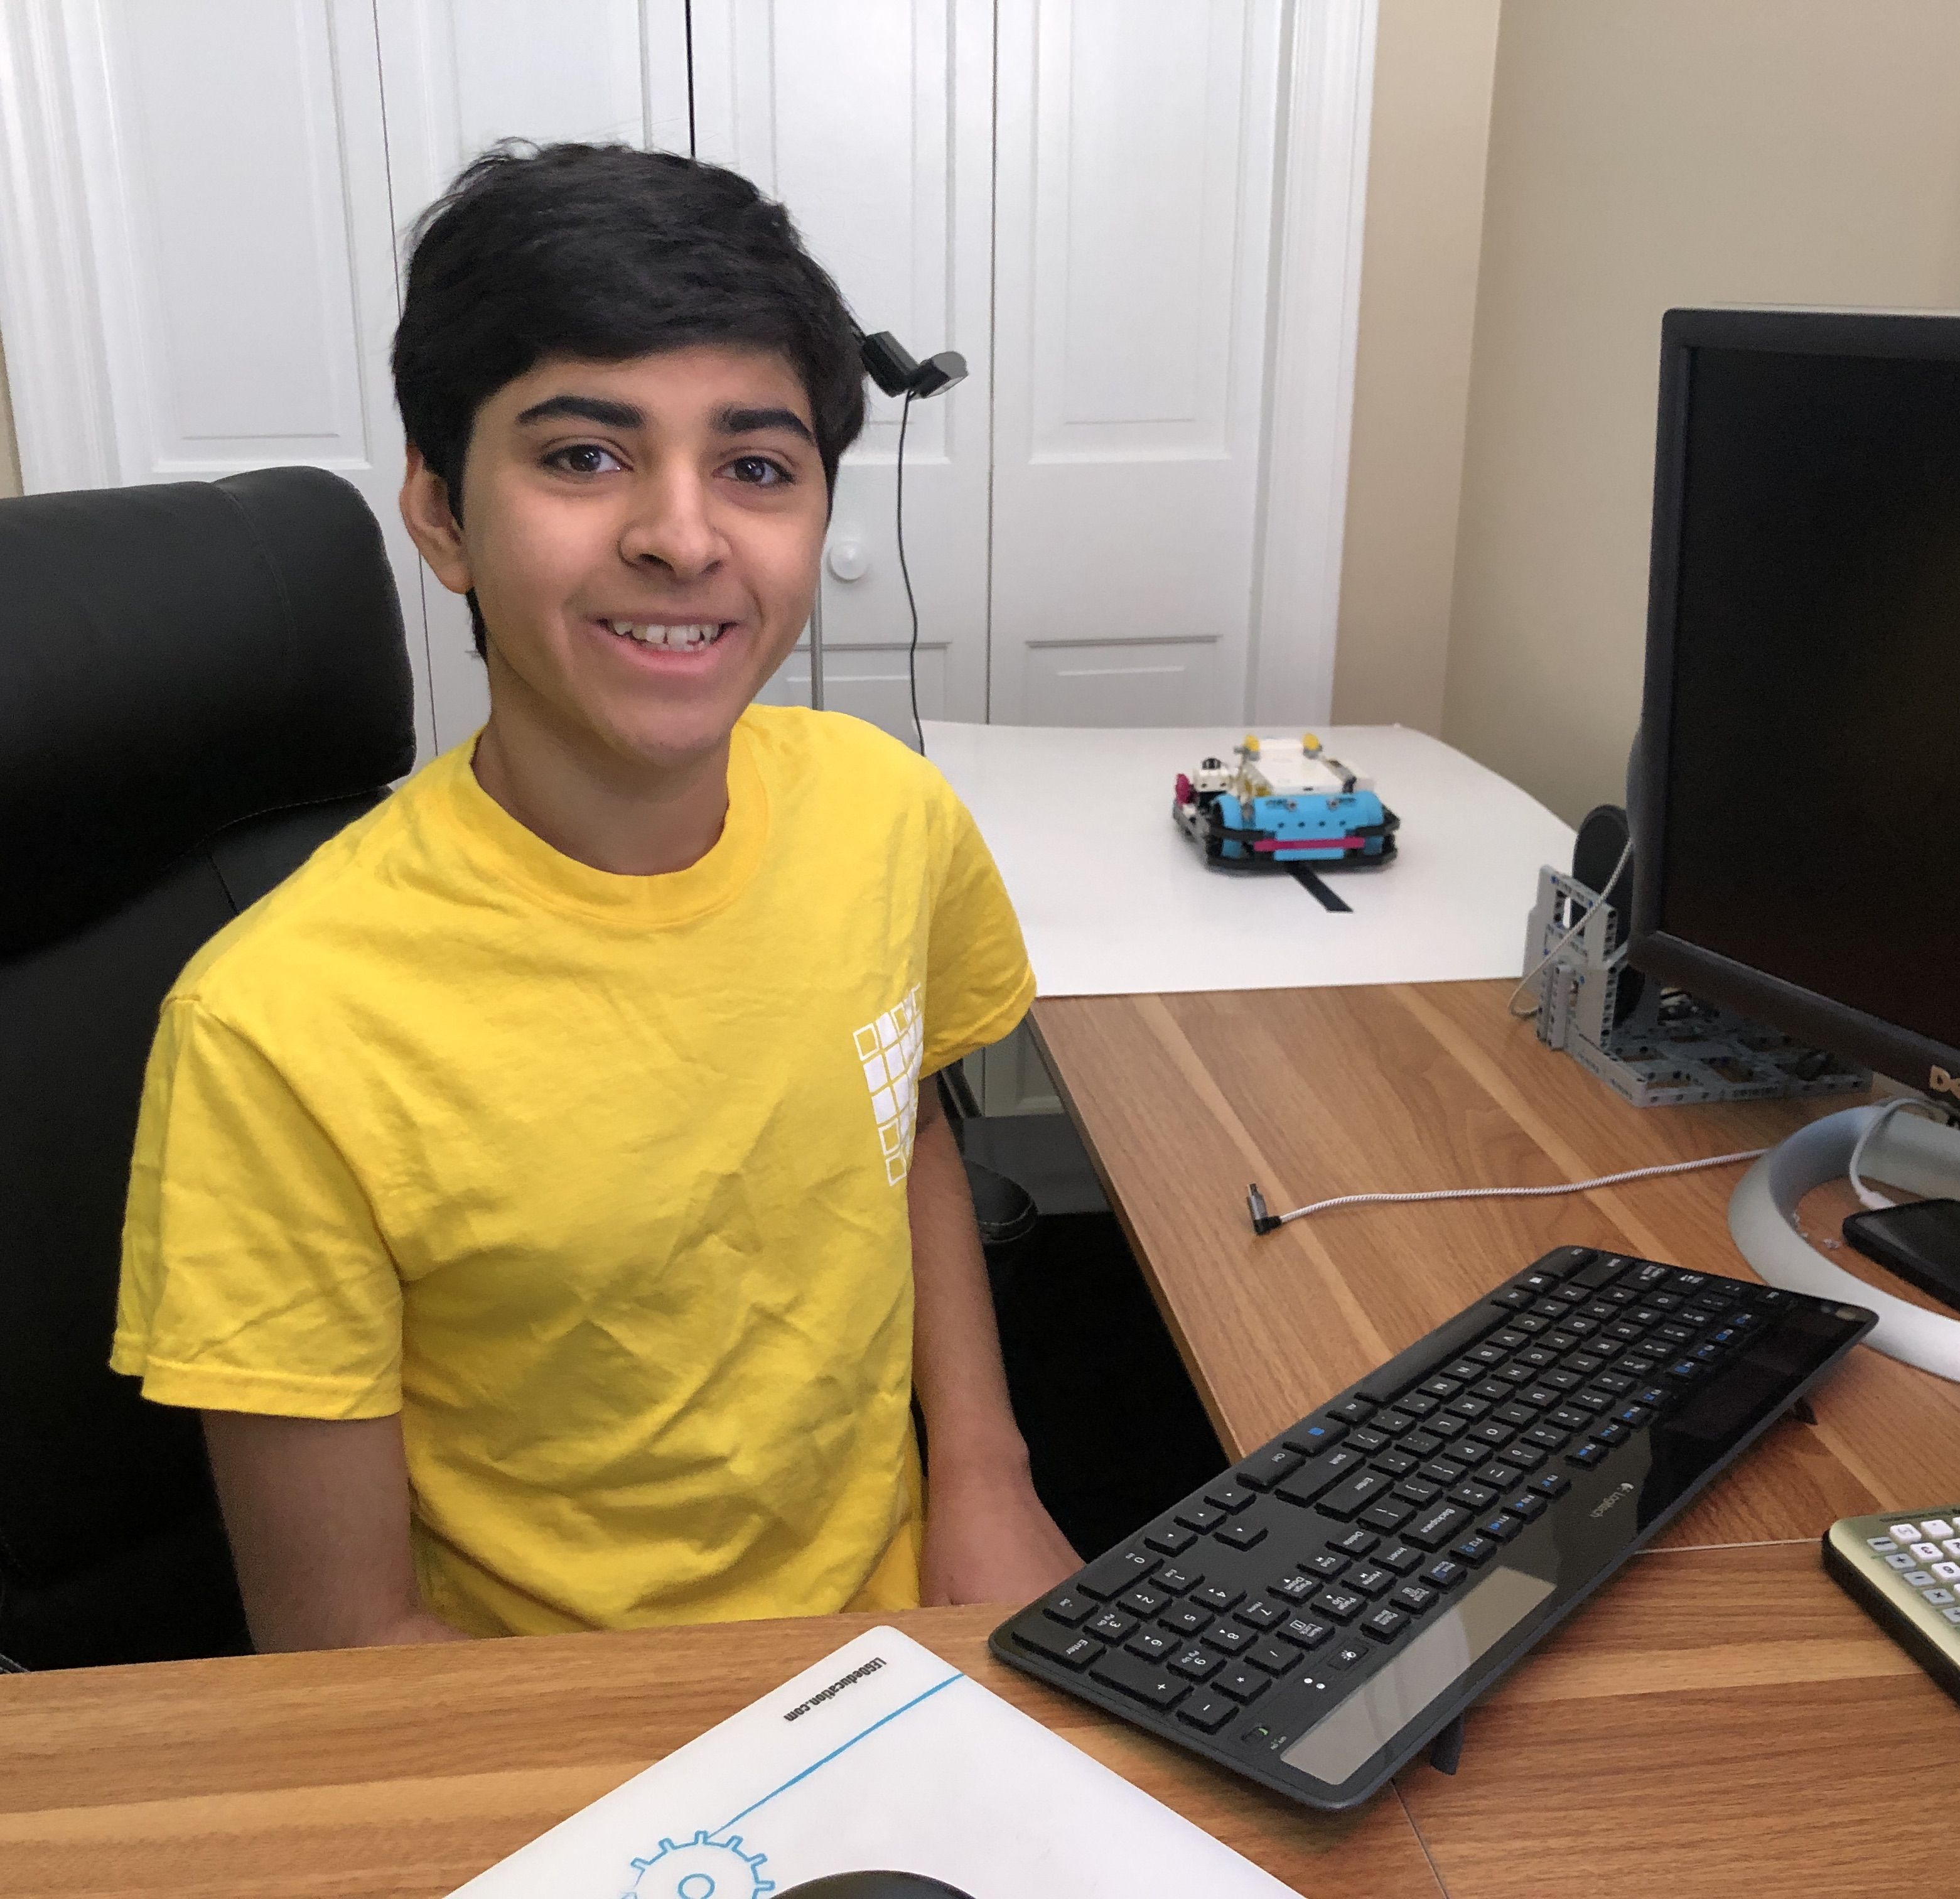
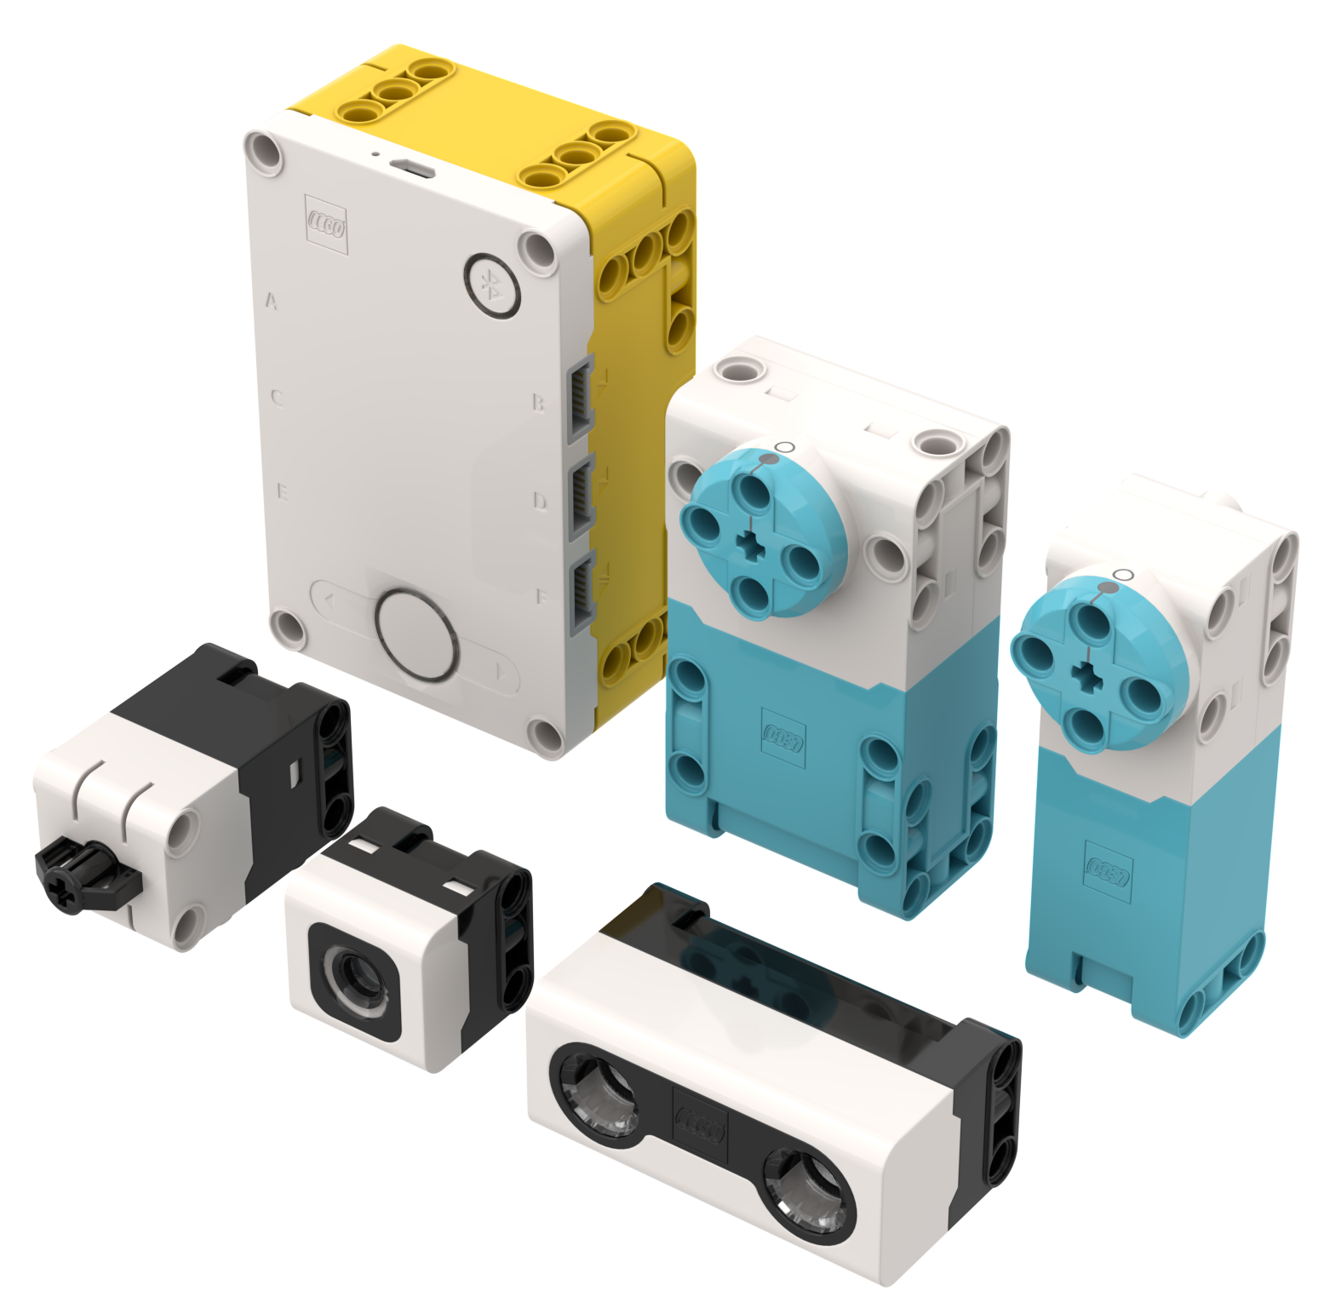
WHO ARE the authors & FOUNDERS?
We are undergraduate students at Massachusetts Institute of Technology.
We started competing in FIRST LEGO League at the ages of 6 and 8.
In 2016, we won First Place Programming at World Festival St. Louis. In 2018, we won First Place Champion’s at World Festival and also had a robot scoring in the top 6.
We authored all the lessons on EV3Lessons.com which are used by more than 850,000 users worldwide. FLLTutorials.com has an additional 150,000 users.
We were selected to be the “First 5” – Two of the first five community members selected by LEGO to give feedback on SPIKE Prime as it was being developed.
We have over 12 years of experience working with, teaching, writing lessons, and competing with LEGO robots.
Arvind
Sanjay

Slide 3
Mission and focus
There are programming lessons available inside the SPIKE Prime software. Those lessons are short, project-based lessons. There is a competition unit included. There are also projects available in Robot Inventor.
Prime Lessons offer a different perspective. We focus on developing programming skills by using a basic training robot with two drive wheels
The skills we teach can be applied to any project or competition
We believe strongly in the need for discovery. At no time will we provide direct solutions to a competition. It is expected that you learn the concept and apply it situations you need in competition
We believe strongly that sensor usage is a valuable tool to increase robot reliability, and so you will find majority of our lessons talk about sensors in some way
Our lessons are designed to be completed in order so that you will have the correct prerequisites for each lesson. They are organized into handy units that build upon each other.

Slide 4
Lesson format
Our lesson content and format are based on 9 years of writing and teaching programming lessons.
We try to keep our lessons short (10-12 slides) on purpose.
Our lessons are not YouTube videos on purpose. However, we will provide a supplemental video to demonstrate robot movement when needed.
Every lesson includes the following components:
Objectives, Main Blocks, Challenge, Solution
Lessons are grouped together into units

Slide 5
PRIME lessons ORGANIZATION
UNIT 1 – Getting Started
How to use these Lessons
Building a Robot
How to Create a Robot in CAD
Easier Building with SPIKE Prime and Robot Inventor
Installing Software and Firmware
UNIT 2 – Intro to Hub and Software
Introduction to Hub and Software
Managing Projects
Viewing Sensor Values
UNIT 3 – Beginner Movement
Configuring Robot Movement
Moving Straight
Turning with Gyro
More Accurate Turns
UNIT 4 – Good Practices
Backing Up Files
Printing Code
Pseudocode
Commenting Code
UNIT 5 – Sensors
Introduction to Force Sensor
Introduction to Color Sensor
Introduction to Distance Sensor
3X3 Light Matrix *
UNIT 6: Intermediate Programming
Using Repeat Blocks/Loops
Using Sound Blocks/Speaker Functions
Using Light Blocks/Light Functions
Using If-Then Blocks/If-Else Statements

Slide 6
PRIME lessons ORGANIZATION
UNIT 7: Intermediate Movement
Moving an Object with Stall Detection
Basic Line Follower
Challenges
UNIT 8 – Advanced Programming Techniques
Introduction to Events
Event Synchronization
Variables
My Blocks
UNIT 9 – Advanced Movement
Acceleration
Squaring on a Line
Proportional Line Follower
Gyro Move Straight
PID Line Follower
UNIT 10 – Additional Competition Skills
Acceleration
Debugging Techniques
Reliability Techniques
UNIT 11 – Robot Inventor*
Machine Learning
Hub-to-Hub * Planned

Slide 7
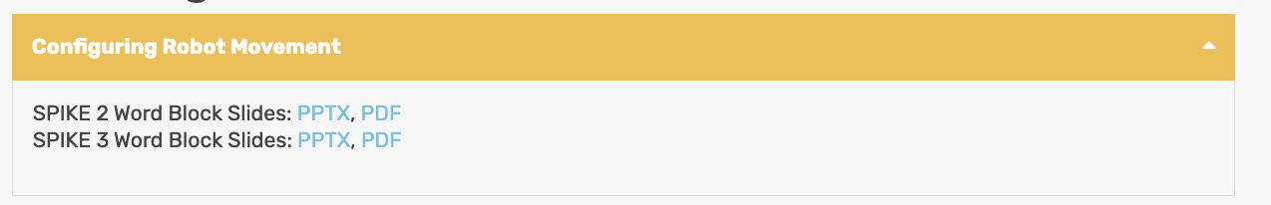
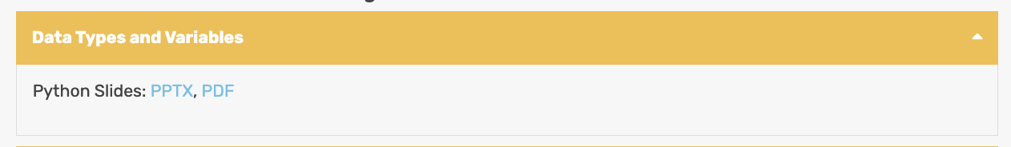
TYPES OF LESSONS
Lessons are available for Word Blocks and Python
Lessons were updated to use SPIKE 3 in 2023.
SPIKE Prime and MINDSTORMS Robot Inventor are very similar, but there are different features and blocks available in each software.

Slide 8

CREDITS
This lesson was created by Sanjay Seshan and Arvind Seshan for Prime Lessons
More lessons are available at www.primelessons.org
This work is licensed under a Creative Commons Attribution-NonCommercial-ShareAlike 4.0 International License.

